Slide 1
Analysis of Improving the spatial solution of electrocardiographic imaging: A new regularization parameter choice technique for the Tikhonov method by J Chamorro-Servent
Kutay Uğurlu
Notes:
In this presentation I will present you the study “” and share the results that I have when I implement in my experimental setup

Slide 2
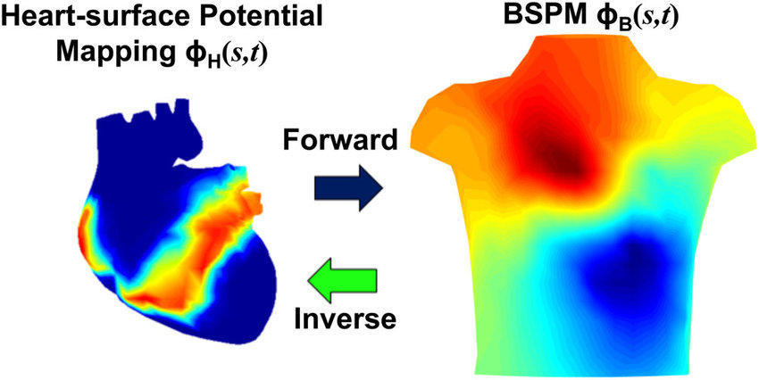
ECGI Inverse Problem
Notes:
Now first lets have a look at the ECG Imaging Inverse problem . In this problem the voltage distribution on the epicardial surface of the heart is being generated from the body surface potential measurements to diagnose conduction abnormalities and the corresponding cardiac diseases, such as infarctions

Slide 3
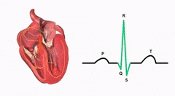
Errors and Ill-posedness
Noise on the measured torso potentials
Uncertainty in the location of measurement sites with respect to the source locations
Errors of segmentation of the geometry
Influence of the cardiac motion
Notes:
This problem is an ill posed problem due to the physical nature of the volume conductor between the electrical sources on the heart and the body surface, which is the human body. This volume conductor has a low pass effect on the measurements, which technically means it is possible that multiple source configurations on the epicardial source could yield the same measurements, hence this is an underdetermined problem due to number of torso measurements. And these are some factors that may drastically change what we reconstruct

Slide 4
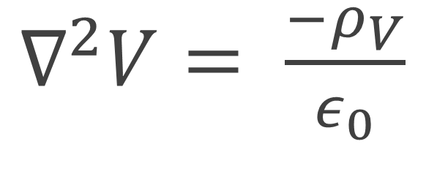
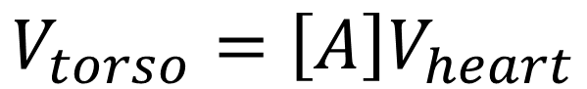
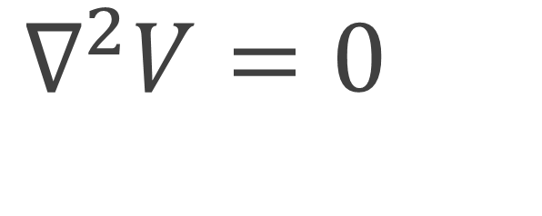
Laplace Equation
$∇^{2}V= \frac{−ρ_{V}}{ε_{0}}$
No source
$∇^{2}V=0$
Green’s Second Theorem
$$V_{torso}=\left[A\right]V_{heart}$$
Notes:
Now I want to talk a little bit about the physical model behind all of this. When we model the cardiac activity as sum of cardiac sources and model the body as pure resistance, we assume that there is no source in the body. And by using greens theorem we integrate both sides and can find a relationship between the measurements and the cardiac sources as in the form of a linear combination

Slide 5
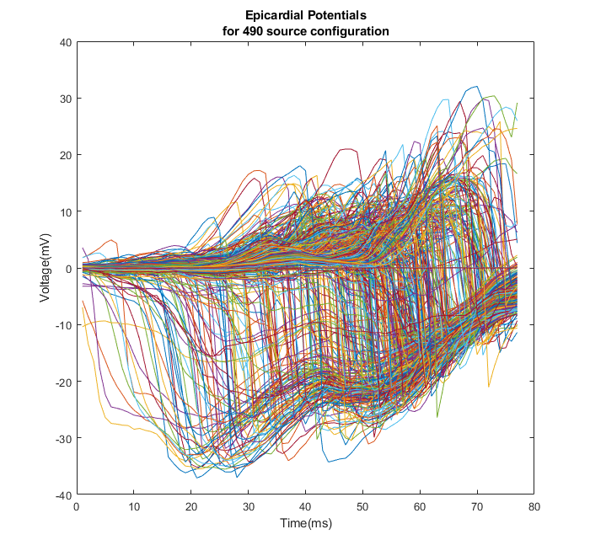
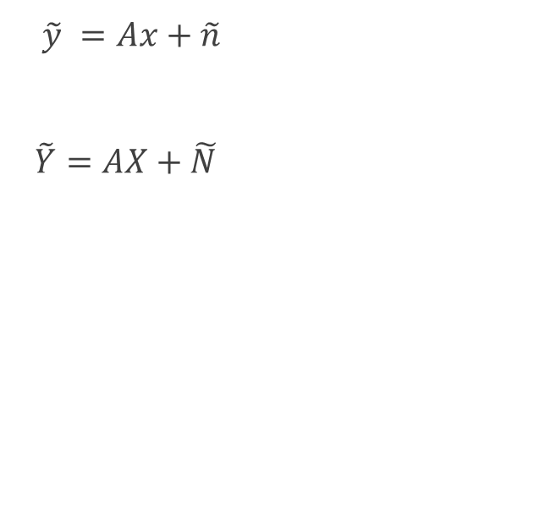
Formulation
$\tilde{y} =Ax+\tilde{n}$
$\tilde{Y}=AX+\tilde{N}$
Notes:
Hence we can formulate the problem in system of linear equations. In this figure, you are seeing an example epicardial beat with 490 cardiac sources for 78 milliseconds Depending on the formulation one can select different forward models for ECGI inverse problem

Slide 6
Methods
Forward Model: Method of Fundamental Solutions (MFS)
Inverse Solution: Tikhonov Regularization
Notes:
In this paper, authors utilize the MFS for forward model and Tikhonov regularizion for the inverse model and they focused on the parameter selection methods for the Tikhonov regularized inverse problem

Slide 7
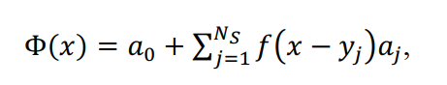
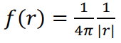
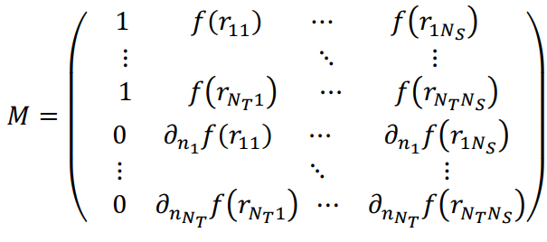
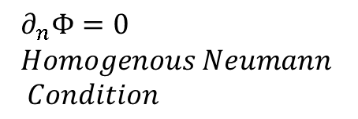
Method of Fundamental Solutions
$$∂_{n}Φ=0 \\ Homogenous Neumann \\ Condition$$
Notes:
MFS is a meshless method. In this method, the voltage on the measurement domain is expressed as the linear combination of fundamental solutions of the Laplacian equation. Half the equations of the system comes from this condition. In addition, using the condition that for any measurement location, the flux, which is the negative derivative of the voltage, coming from the source points should be equal to zero. This homogenous neumann conditions are introduced to the system

Slide 8
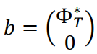
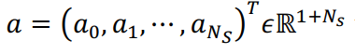
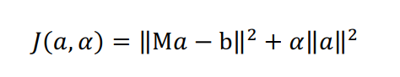
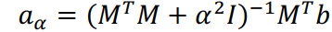
Tikhonov Regularization Formulation
Notes:
With this system matrix, the Tikhonov regularized solution is defined like this It is exactly same . Now we search for the suitable alpha

Slide 9
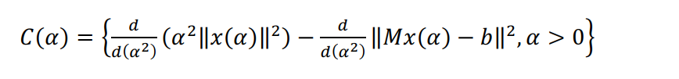
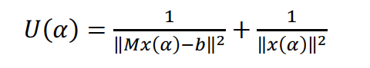
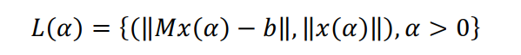
Choice of Regularization Parameter α
CRESO
L-Curve
U-Curve
Automated Discrete Picard Condition **
Notes:
There are some different regularization cost functions . CRESO method search for the first local maximum of the difference between squared L2 norms of data-fidelity and constrain terms
U and L curves use these two cost functions and find the point having the maximum curvature and the corresponding regularization parameter.

Slide 10
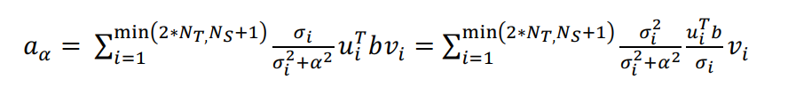
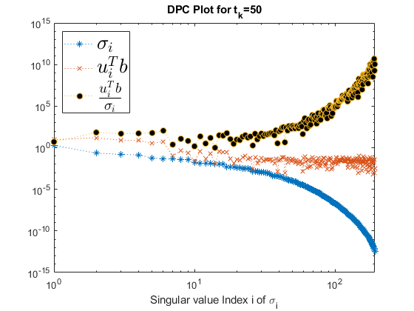

Discrete Picard Condition
DPC starts to fail when $\frac{|u_{i}^{T}b|}{σ_{i}}$ starts to increase and the solution is completely dominated by smaller SVs.
Notes:
We can express solution in terms of SVD analysis. Here we have the Tikhonov SVD filtering. We rewrite this term by dividing and multiplying That is, the 𝜎𝜎𝑖𝑖 above the regularization parameter 𝛼𝛼 (useful SVs) must decay to zero slower than the corresponding right hand side coefficients, | 𝑢𝑢𝑖𝑖𝑇𝑇𝑏𝑏|

Slide 11
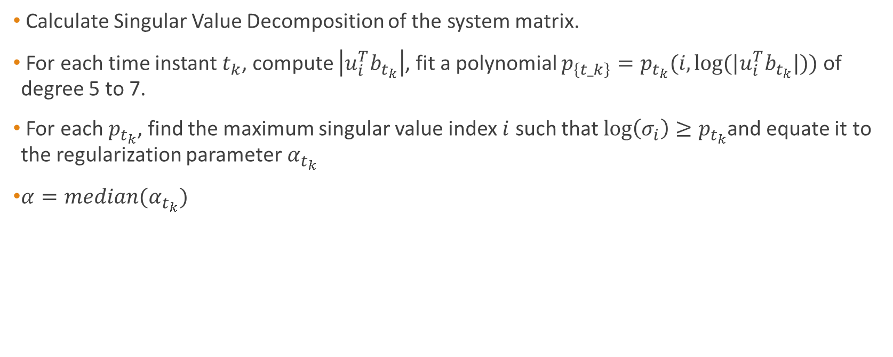
Automated Discrete Picard Condition (ADPC)
Calculate Singular Value Decomposition of the system matrix.
For each time instant $t_{k}$, compute $\left|u_{i}^{T}b_{t_{k}}\right|$, fit a polynomial $p_{\left\{t_k\right\}}=p_{t_{k}}(i,log⁡(|u_{i}^{T}b_{t_{k}}|))$ of degree 5 to 7.
For each $p_{t_{k}}$, find the maximum singular value index $i$ such that $\log\left(σ_{i}\right)≥p_{t_{k}}$and equate it to the regularization parameter$α_{t_{k}}$
$α=median(α_{t_{k}})$

Slide 12
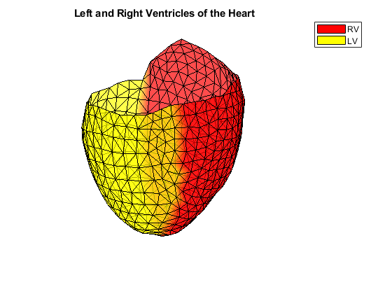
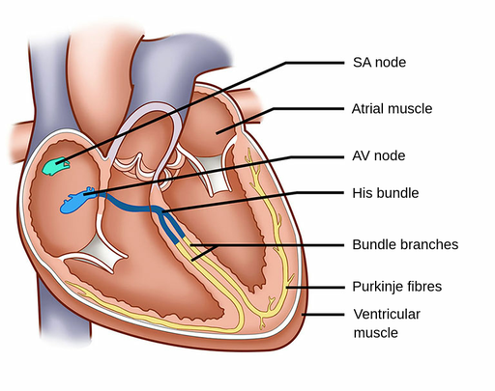
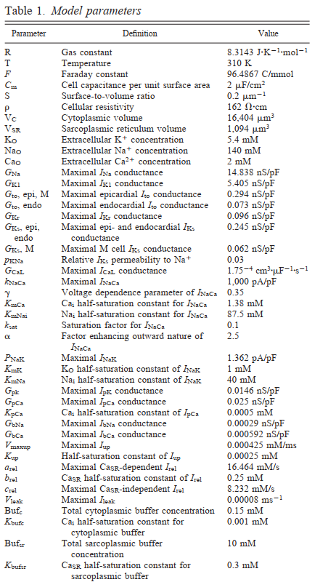
Dataset Generation
To test the effect of the new regularization parameter choice method and to compare with previous ones, eight different activation patterns (1 single site pacing in the right ventricular (RV) free wall, 1 single site pacing in the left ventricular (LV) lateral endocardial wall, 1 single site pacing in the LV mid wall, 1 single pacing site in the LV lateral epi and 4 single spiral waves) were simulated [19]. Propagating activation was simulated with a monodomain reaction-diffusion model in a realistic 3D model of the human ventricles, with transmembrane ionic currents computed with the Ten Tusscher et al. model for the human ventricular myocyte.
Notes:
SA Node in a healthy heart is responsible for the pacemaking of the heart. However, in cases where the heart has some conduction abnormalities, this point where the electrical signals start to propagate can change. For this, the experiments are done by changing the location of the pacing site. They uses the pacing sites given here. The heart model and torso model are based on the MRI data, and heart model has .2mm spatial resolution and the simulation has 1ms temporal resolution.

Slide 13

Modifications in the re-implementation

Slide 14
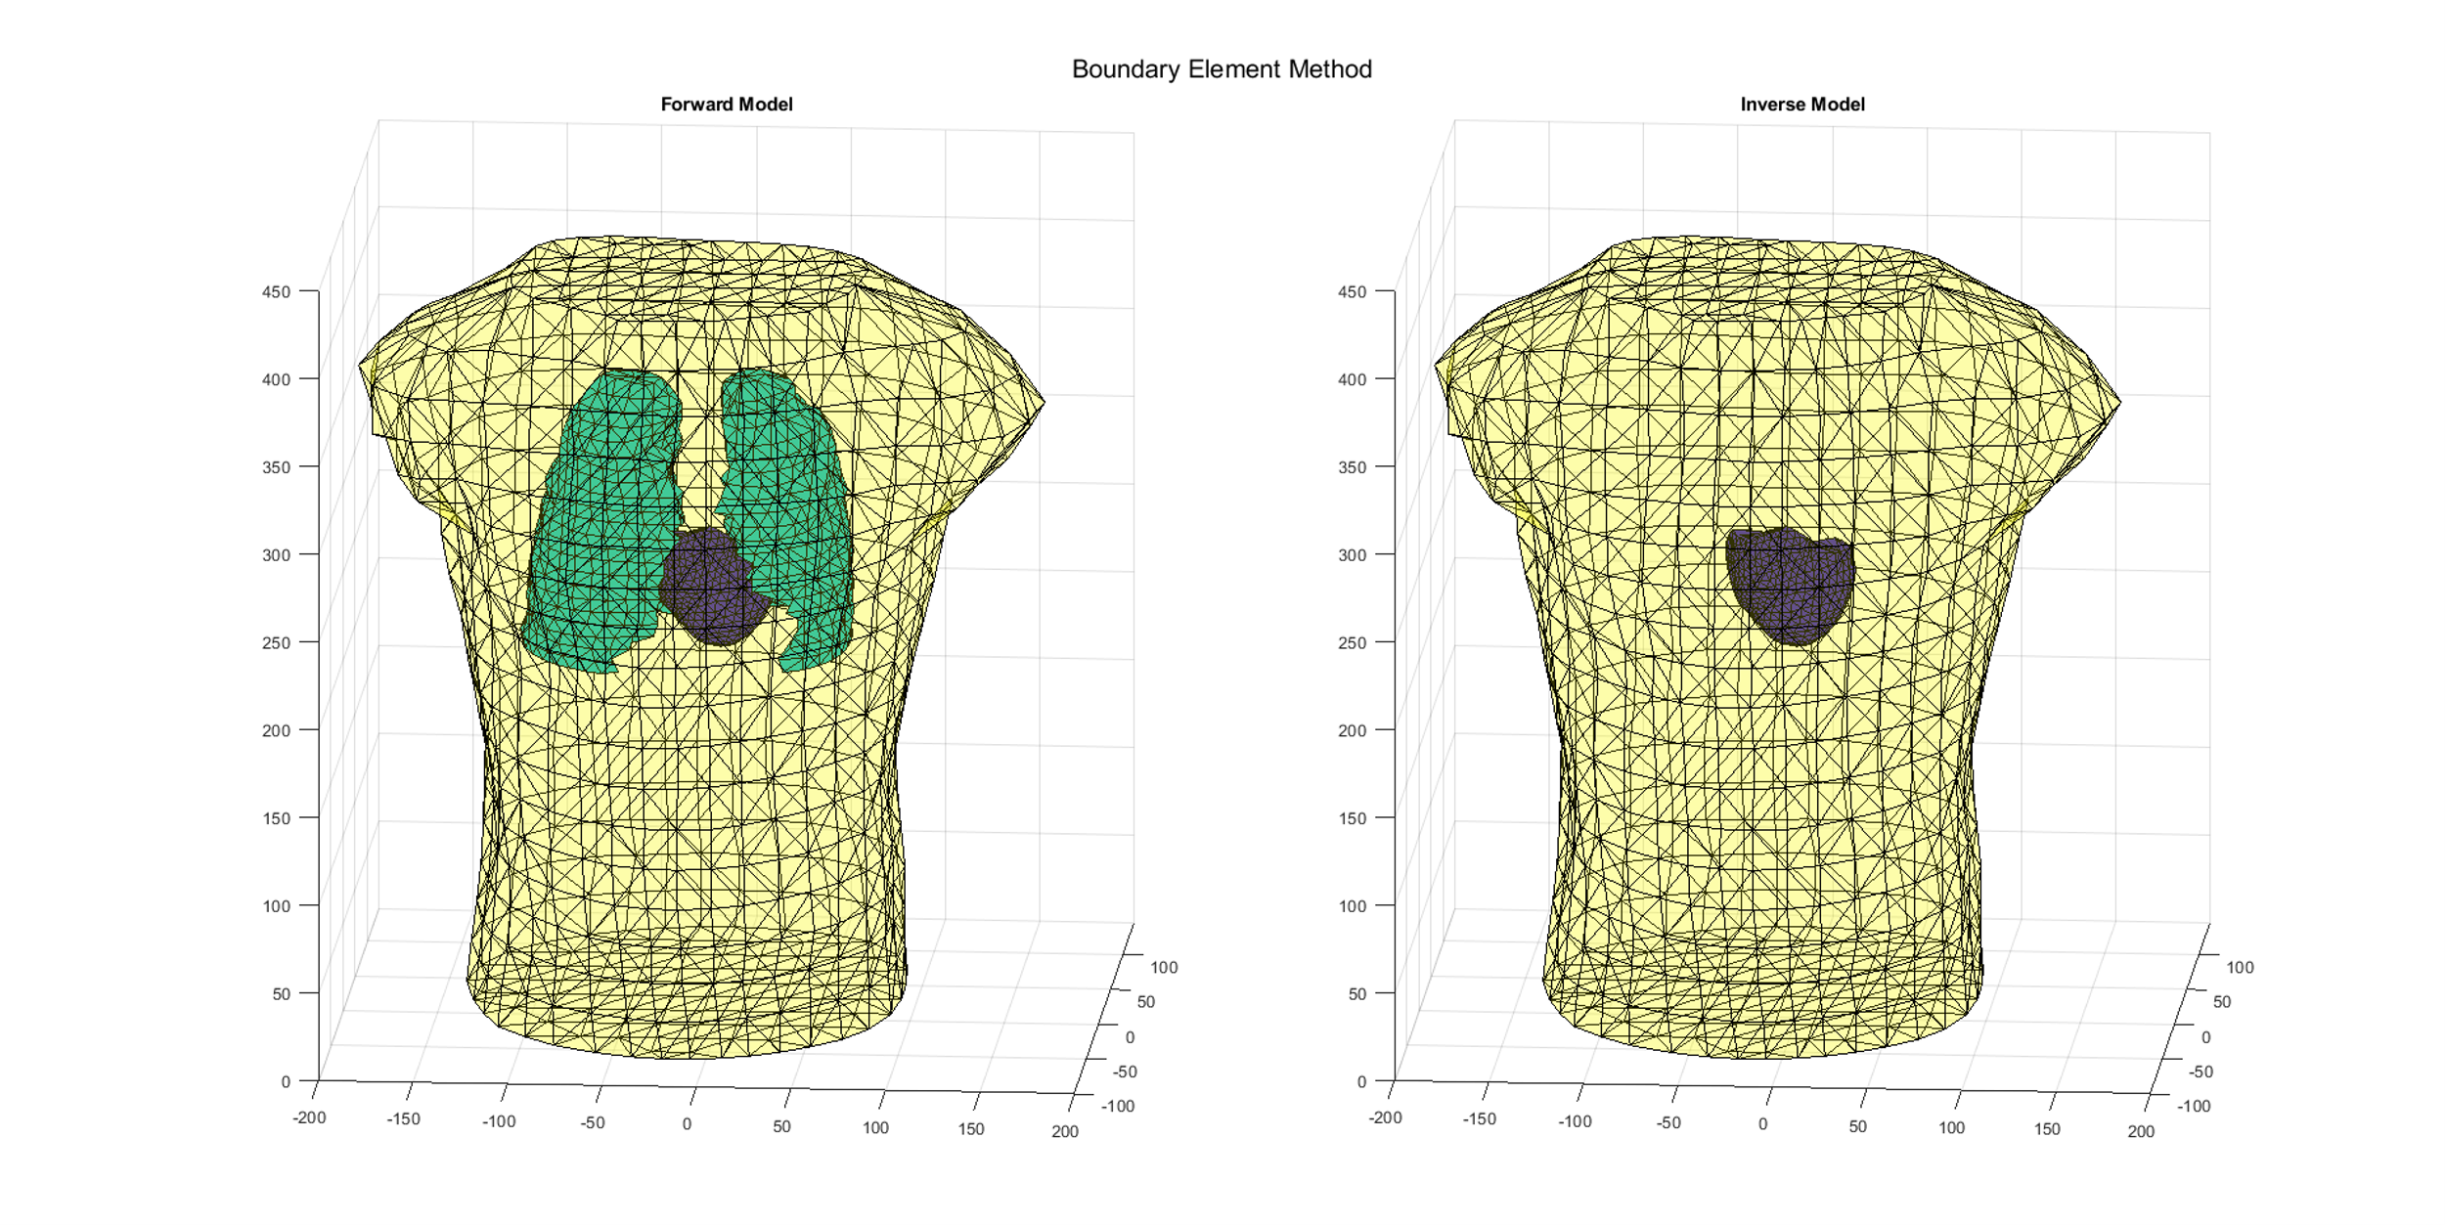
Boundary Element Method
Notes:
I have used a different dataset including torso-tank measurement data where I already have the ground truth epicardial potentials. As for forward model generation I use BEM, which is a mesh method where the mapping between the measurement sites and source locations are calculated also considering the conductivity maps between the domains. To generate body surface potential mappings I used a Heart Lungs Torso forward model. To avoid inverse crime, I utilized homogenous heart torso model for the inverse problem here. Then the BSPMs are corrupted by 30 dB noise

Slide 15
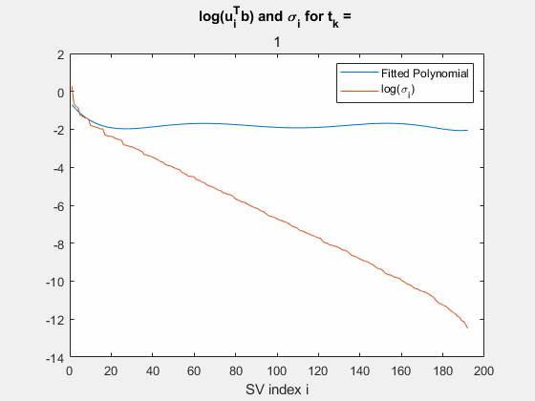
New parameter: Ratio
Notes:
When I directly utilized the same approach in the original study, my solution were over regularized due to the relation between uitranspose b and sigmas in my system. The authors of the study state in the conclusion that the study must be repeated when another numerical method such as BEM is utilized. Then I have loosened the DPC, in other words, changed the point where I assumed the divergence starts by a ratio.

Slide 16
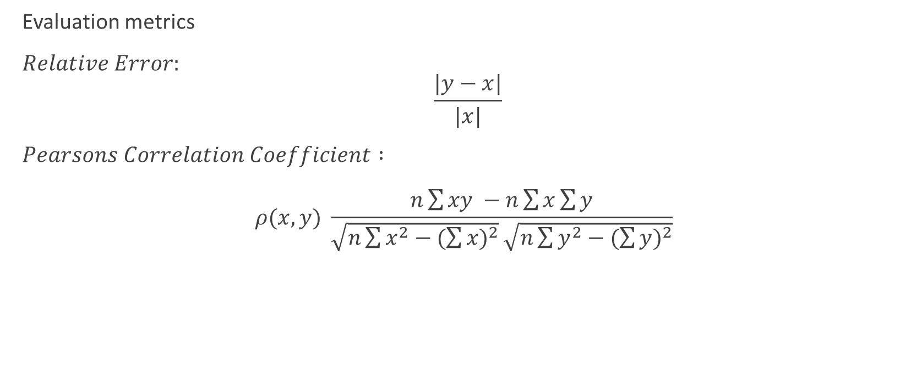
Results
Evaluation metrics
$Relative Error:$ $\frac{|y−x|}{|x|}$
$Pearsons Correlation Coefficient :$ $ρ(x,y) \frac{n\sum{xy −n\sum{x}\sum{y}}}{\sqrt{n\sum{x^{2}−{(\sum{x})}^{2}}}\sqrt{n\sum{y^{2}−{(\sum{y})}^{2}}}}$

Slide 17
Temporal
Spatial
Notes:
Like authors, I have utilized this metrics in the temporal direction to have a better understanding of how successful an electrogram is reconstructed.

Slide 18
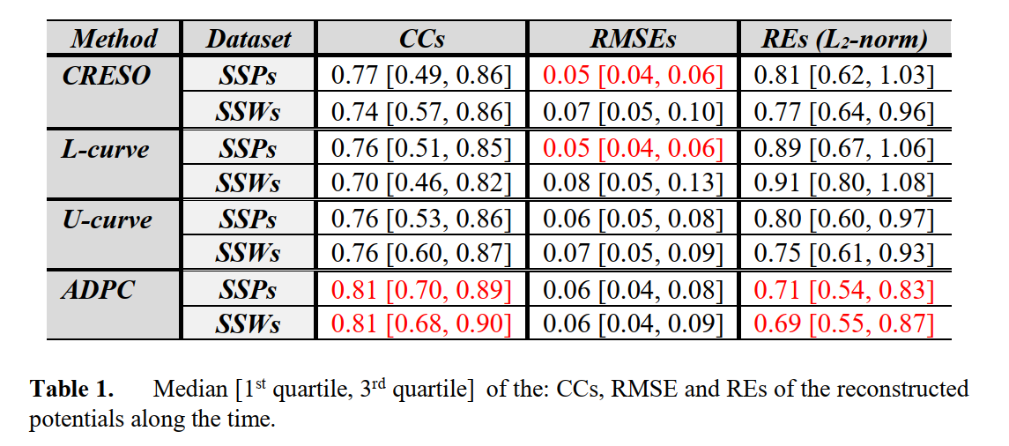
Notes:
In this table best results are in red color

Slide 19
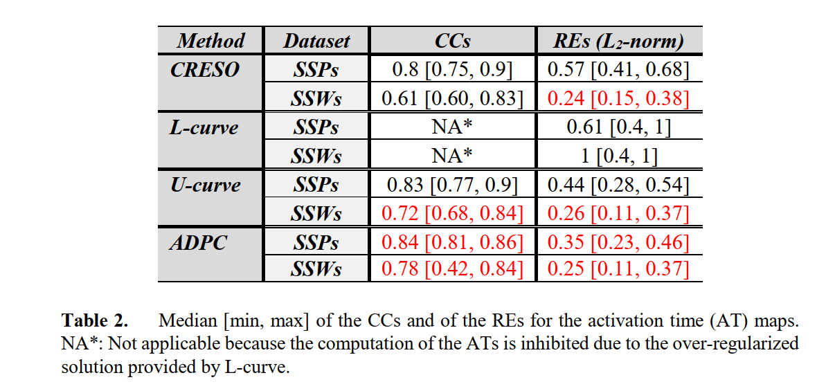
Notes:
When the reconstructions are done, we want to find where the pacing site is. We determine the point having the minimum delta v over delta t instant for each electrogram and we mark the node having the minimum activation time as pacing site location.

Slide 20
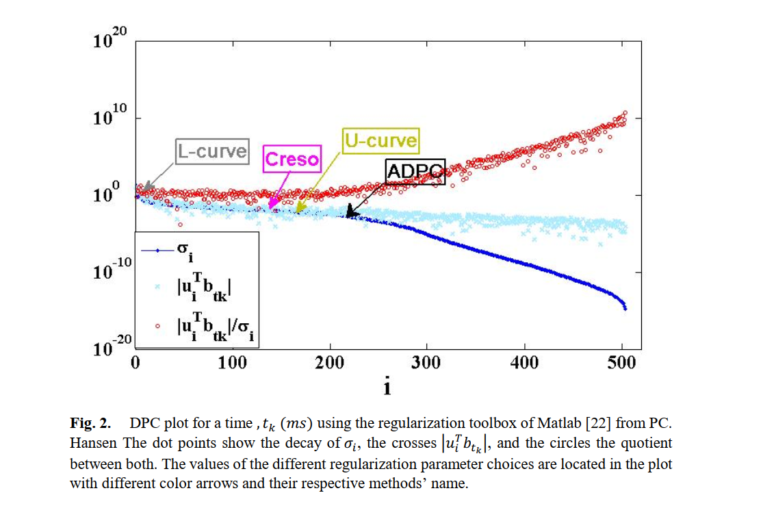
Notes:
And it is obvious from these Picard plot that the lambda parameter given by the L curve results in an over regularized solution, in other words, it puts remarkable weight to the constraint in the optimization

Slide 21
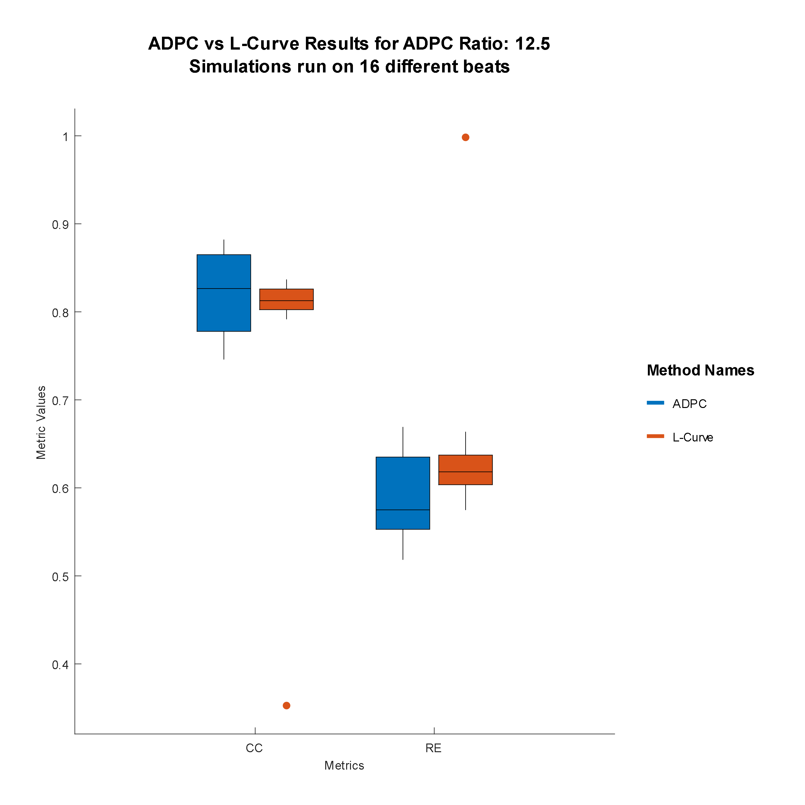
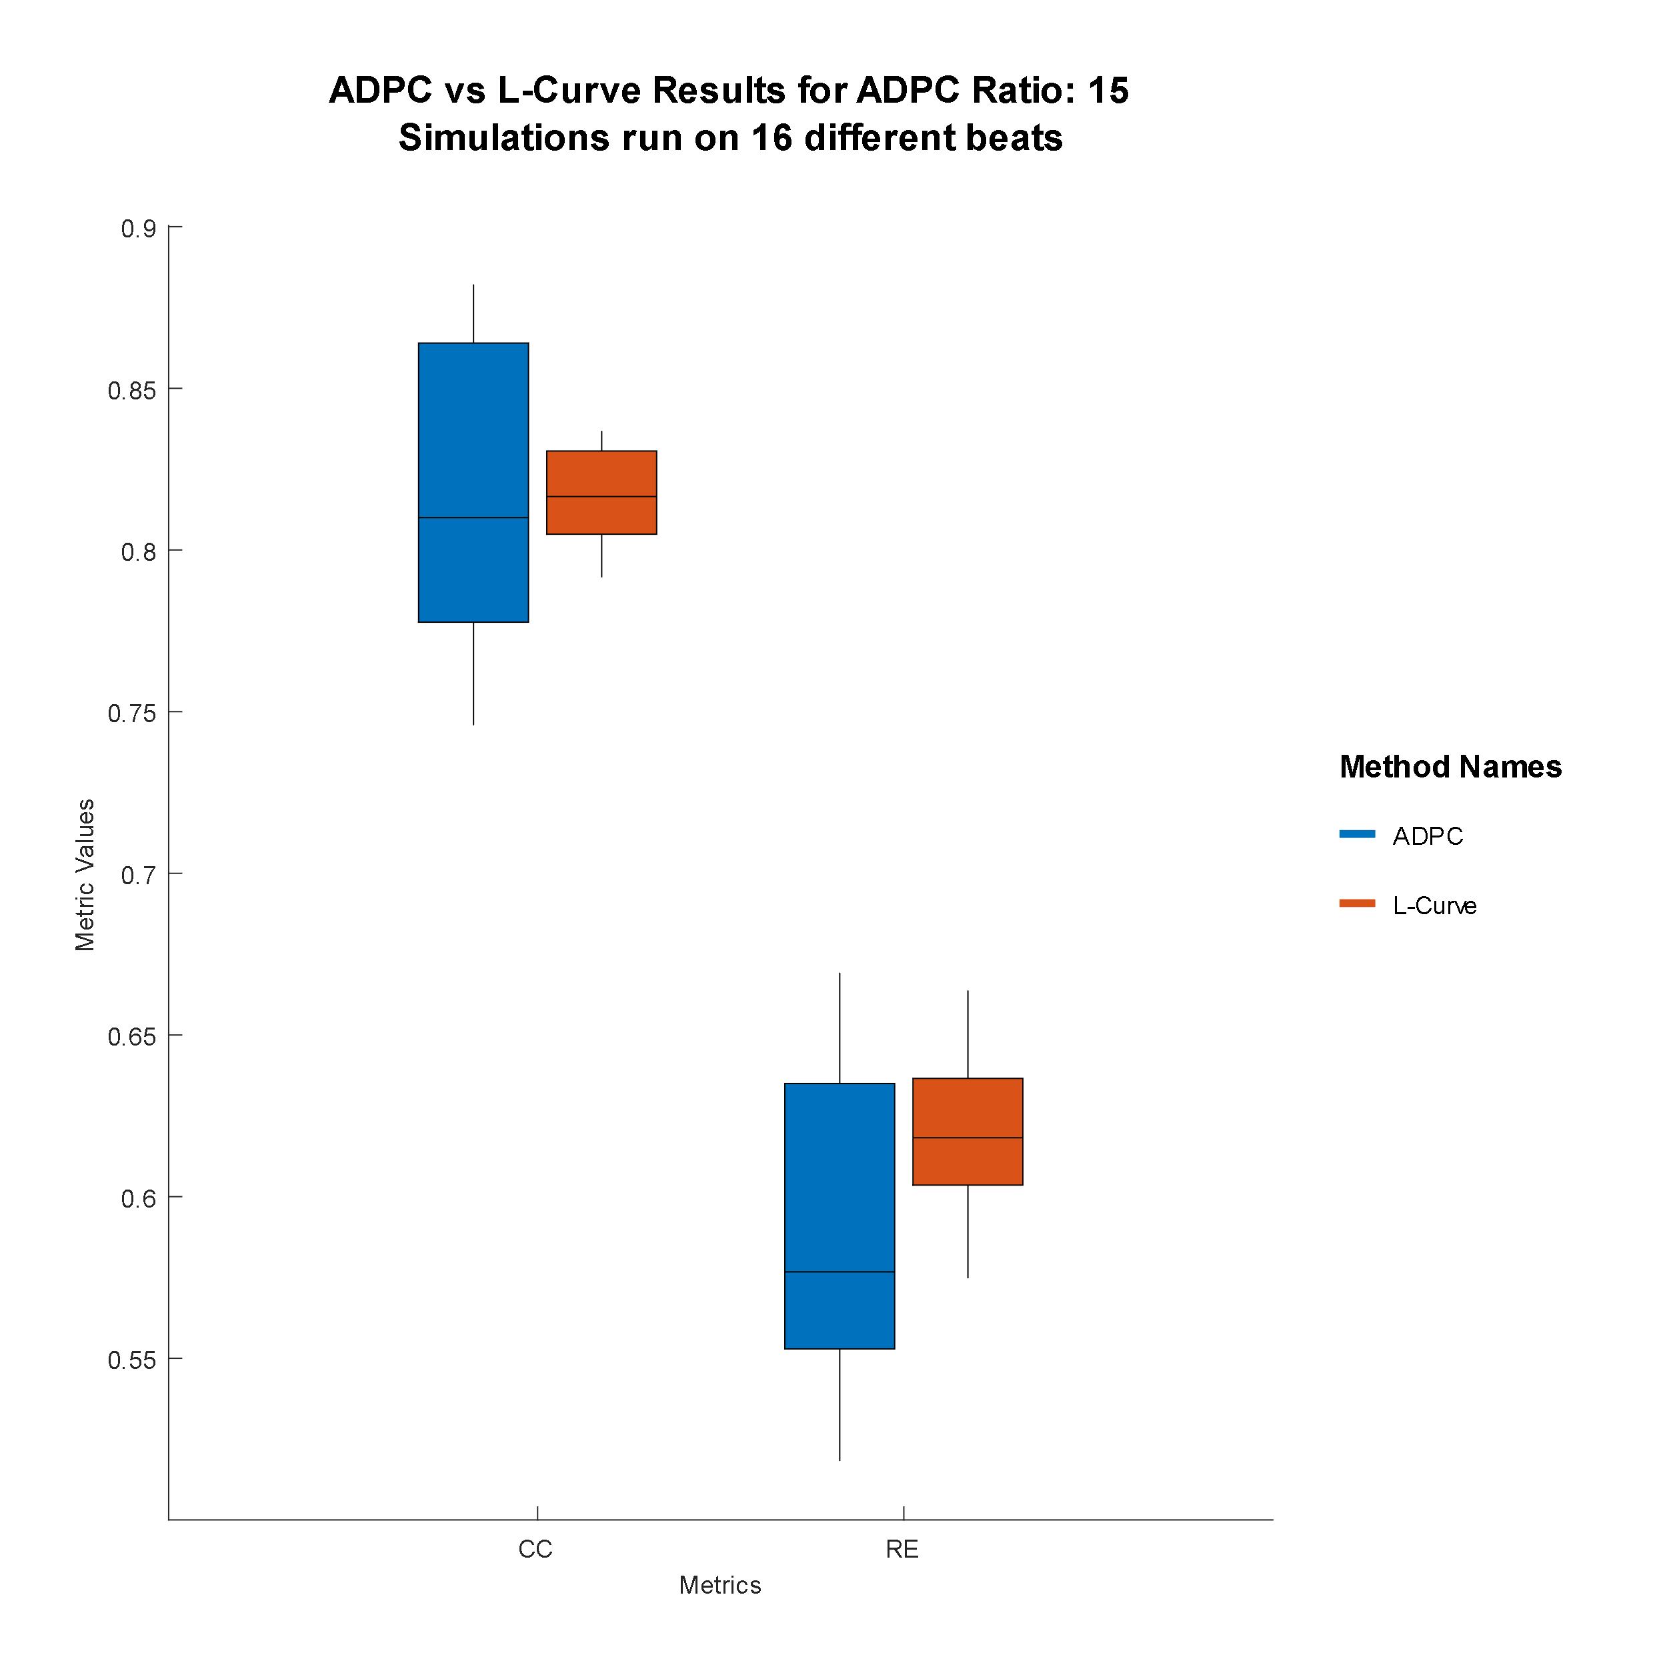
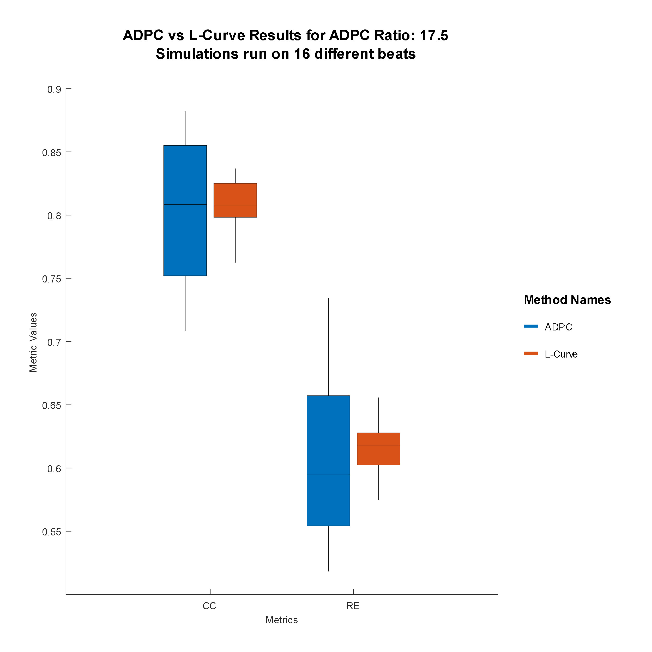
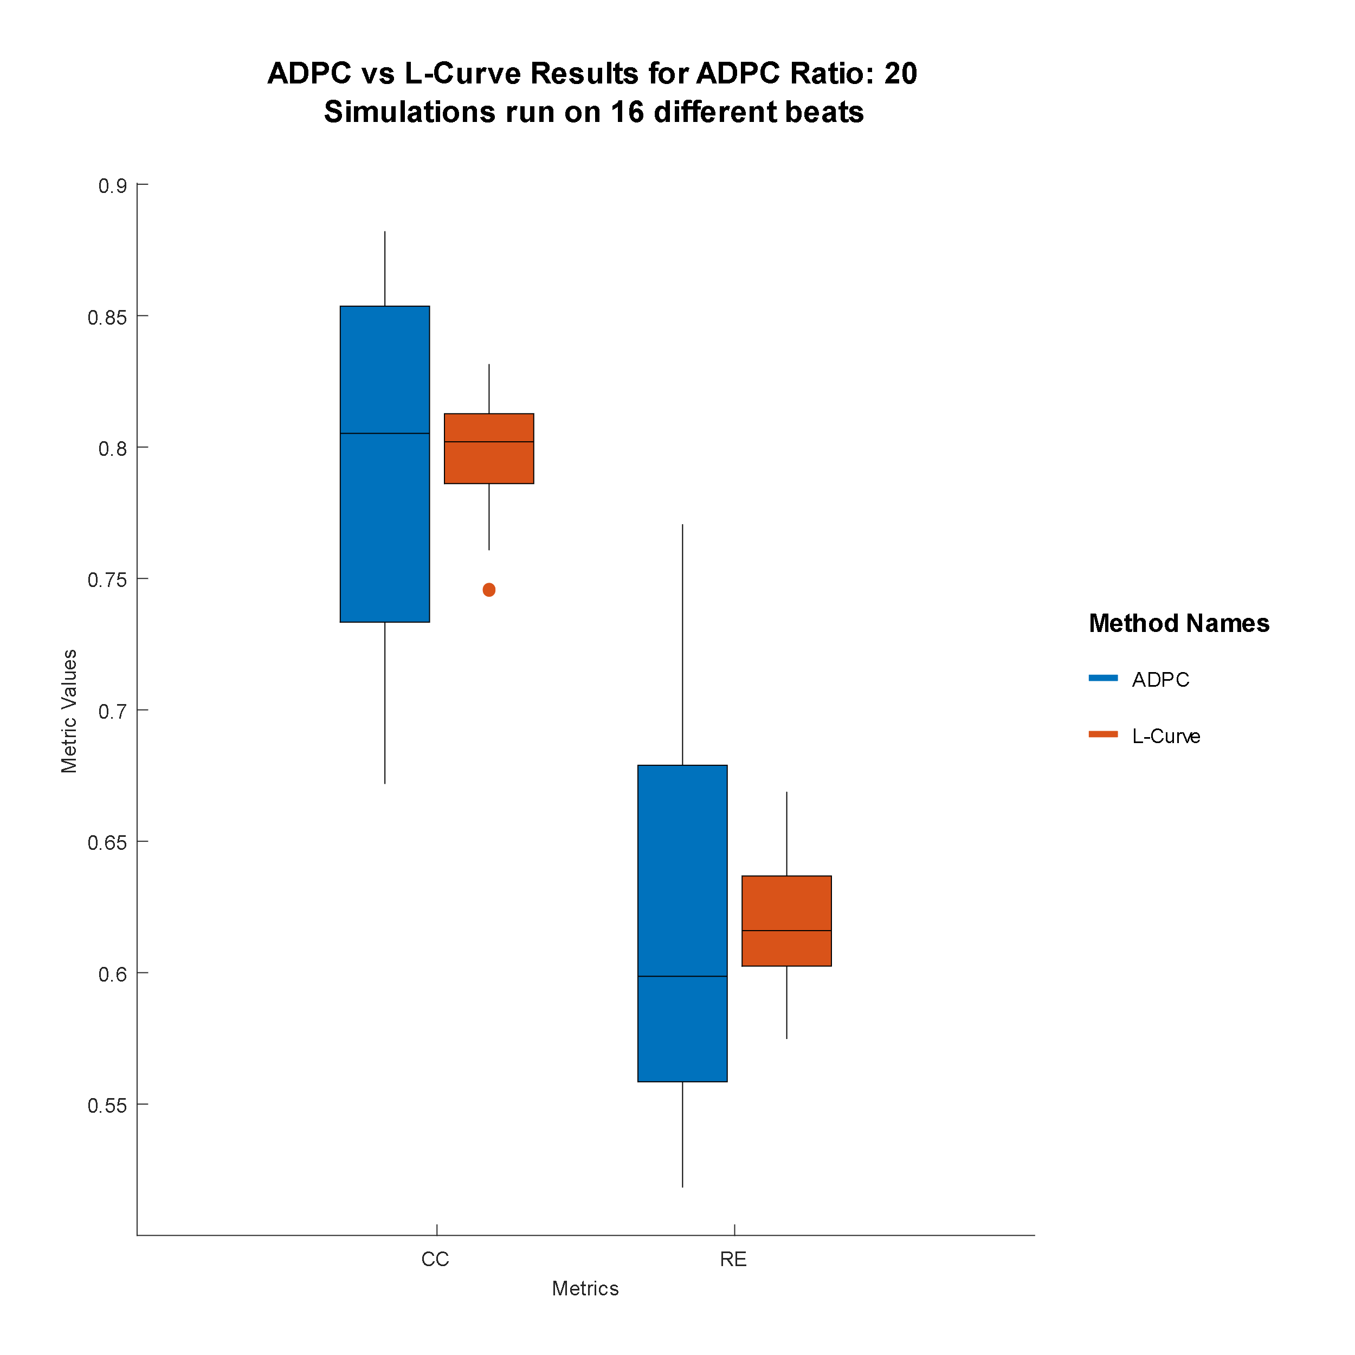
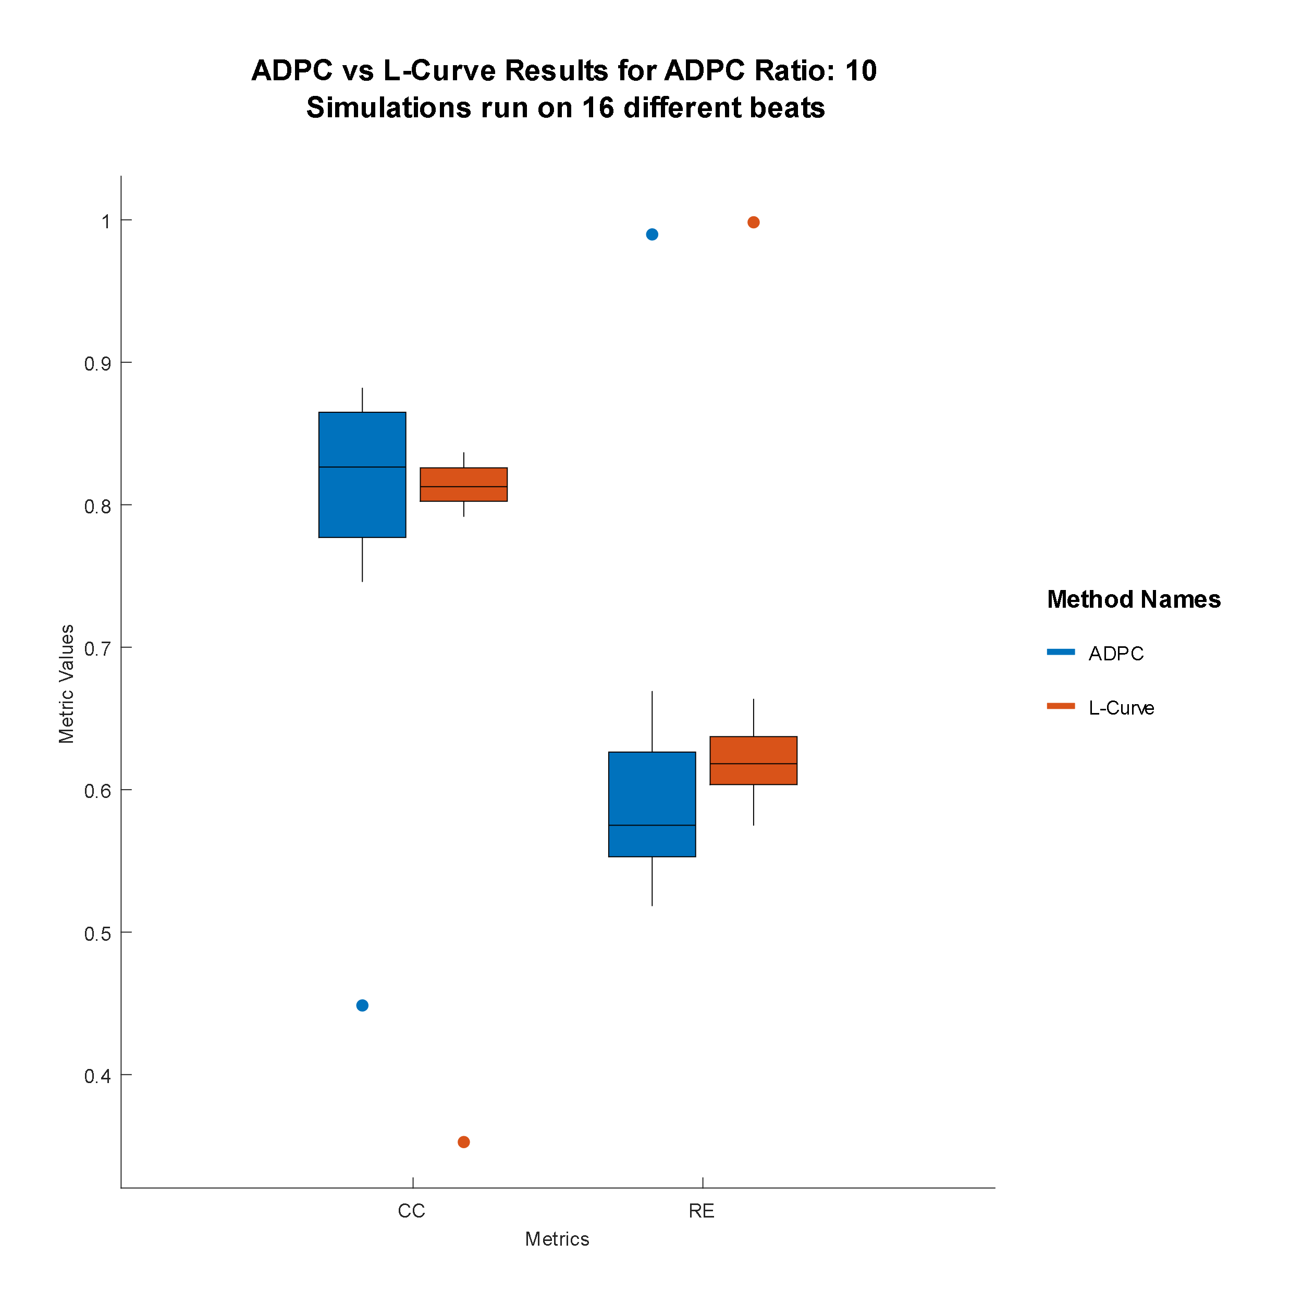
Notes:
Now, I want to elaborate on my implementation. The ratio parameters are searched experimentally via these box plots. These boxes represent the median CC and RE values from 16 test data. What we can instantly observe is that ADPC results in wider range of metrics in both good and bad directions independent from the ratio.

Slide 22
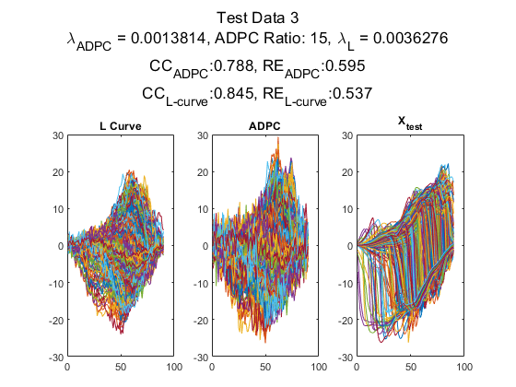
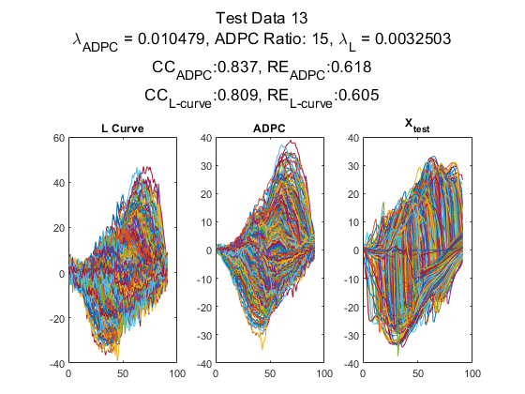
Reconstruction comparisons
Notes:
These are reconstructions for ratio equals to 15 case. In the figure on the left we see a test beat where L curve outperformed the ADPC and we observe the opposite situation in the figure on the right.

Slide 23
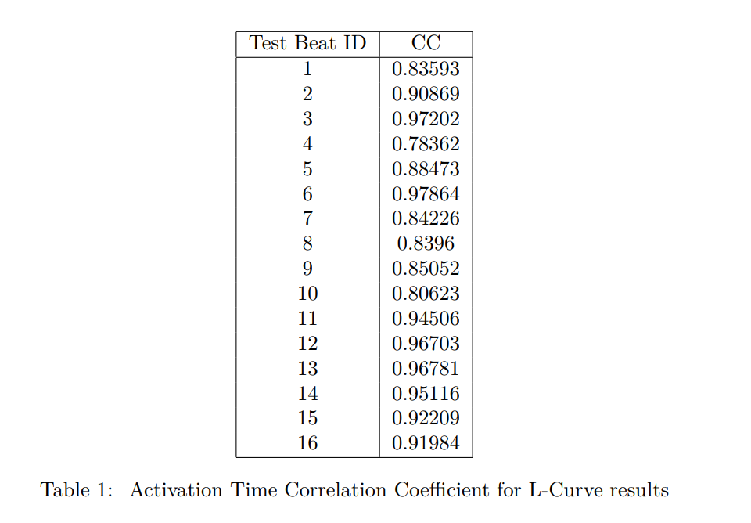
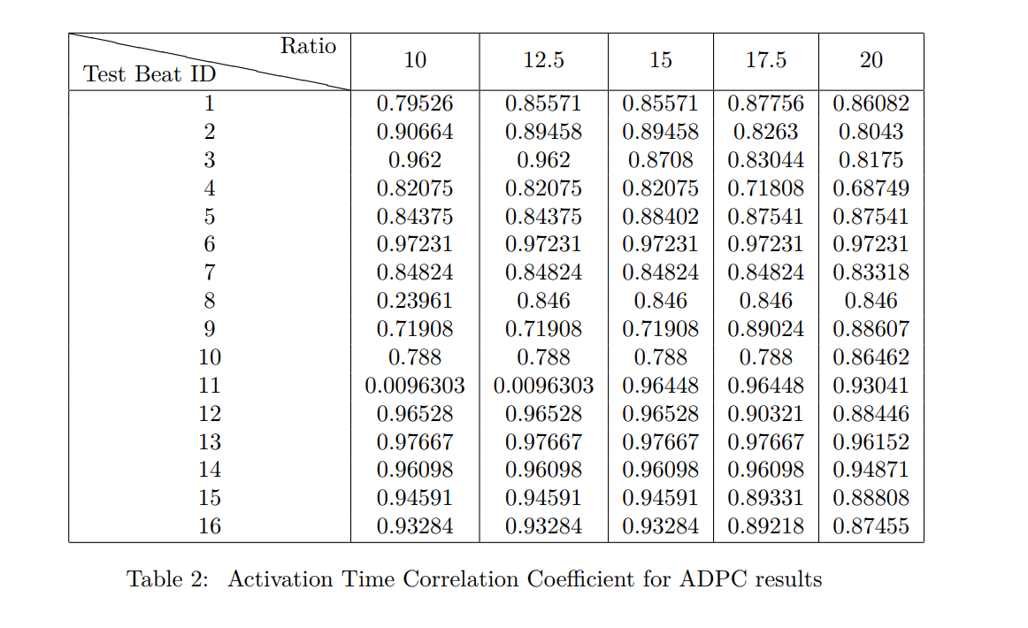
Activation Time Maps
Notes:
Eleventh beat is an interesting example, it shows the importance of the ratio in my system

Slide 24

References
“Figure 2. the illustration of forward and inverse ECG problems.” [Online]. Available: https://www.researchgate.net/figure/The-illustration-of-forward-and-inverse-ECG-problems_fig2_344270543. [Accessed: 29-Jun-2022].
Theory.labster.com. 2022. Sinoatrial node - Labster Theory. [online] Available at: <https://theory.labster.com/si_node/> [Accessed 29 June 2022].
“ECGI methodology,” Wustl.edu. [Online]. Available: https://rudylab.wustl.edu/research/noninvasive-electrocardiographic-imaging-ecgi/ecgi-methodology/. [Accessed: 29-Jun-2022].
R. S. MacLeod, B. Taccardi and R. L. Lux, "Electrocardiographic mapping in a realistic torso tank preparation," Proceedings of 17th International Conference of the Engineering in Medicine and Biology Society, 1995, pp. 245-246 vol.1, doi: 10.1109/IEMBS.1995.575092.
P. Morel, “Gramm: grammar of graphics plotting in Matlab,” J. Open Source Softw., vol. 3, no. 23, p. 568, 2018.

